Slide 1
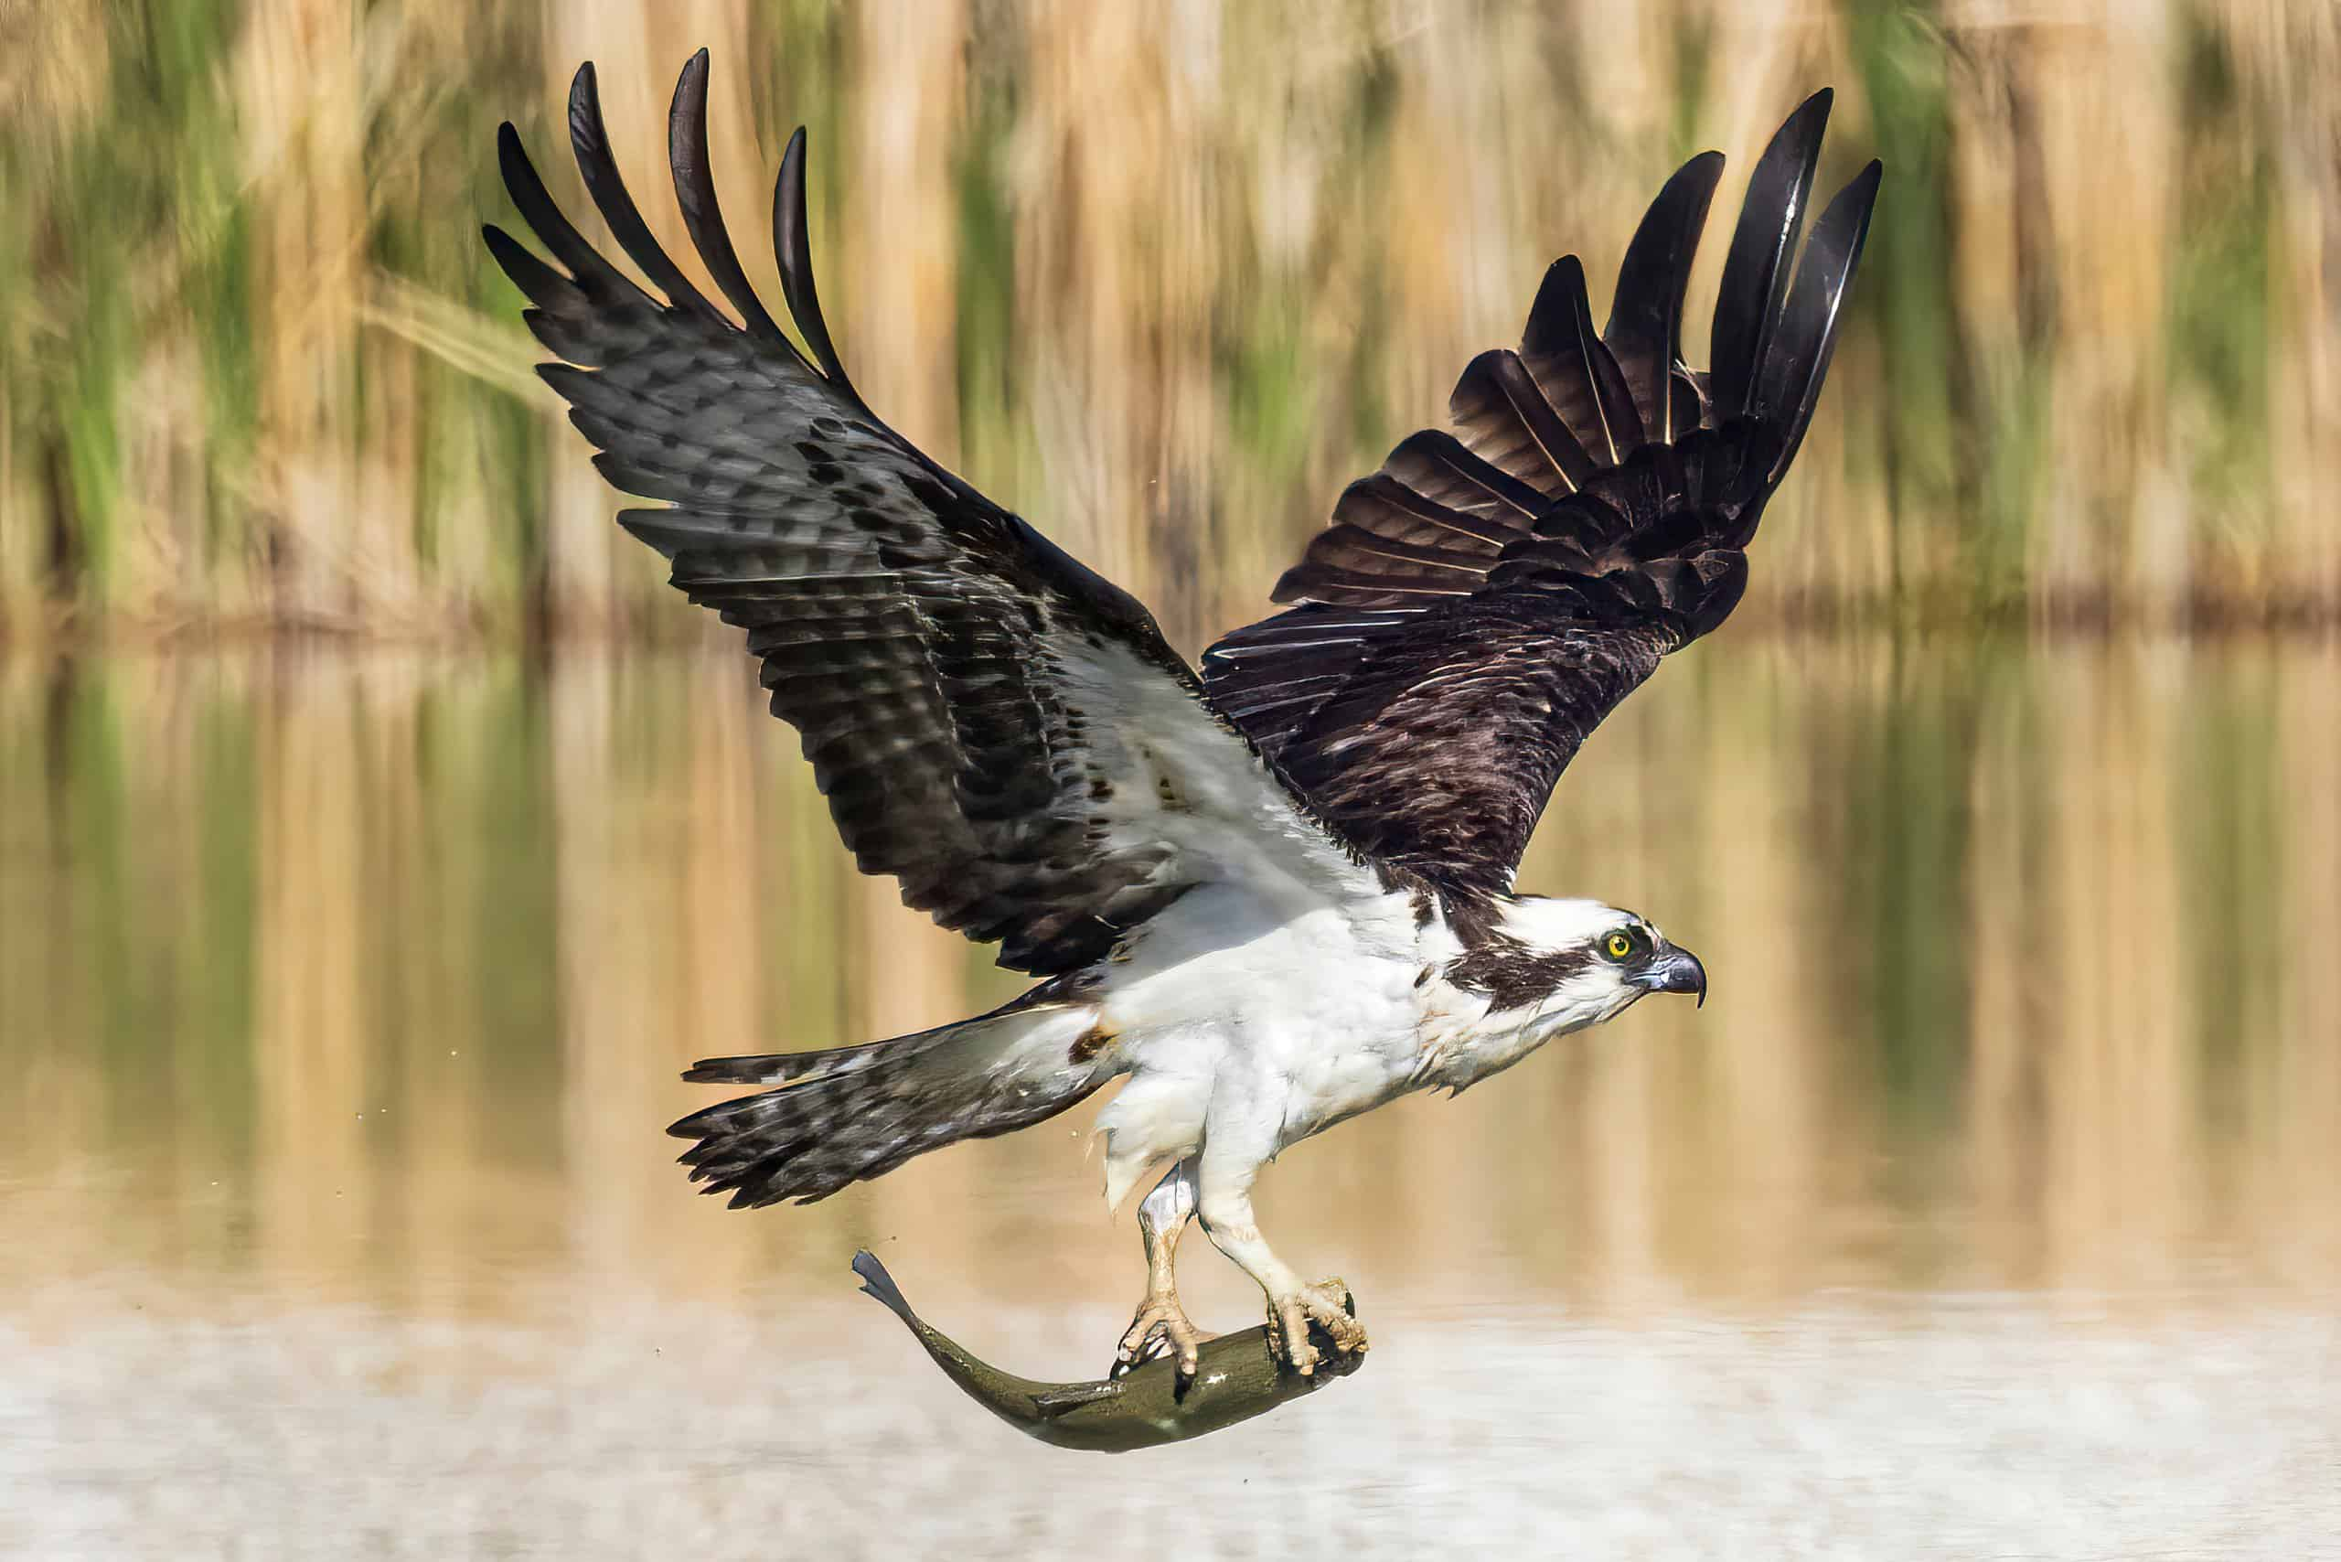
Osprey – Public Safety Initiative
Steven Gurney
Notes:
Proactive initiative kickstarted in 2024

Slide 2
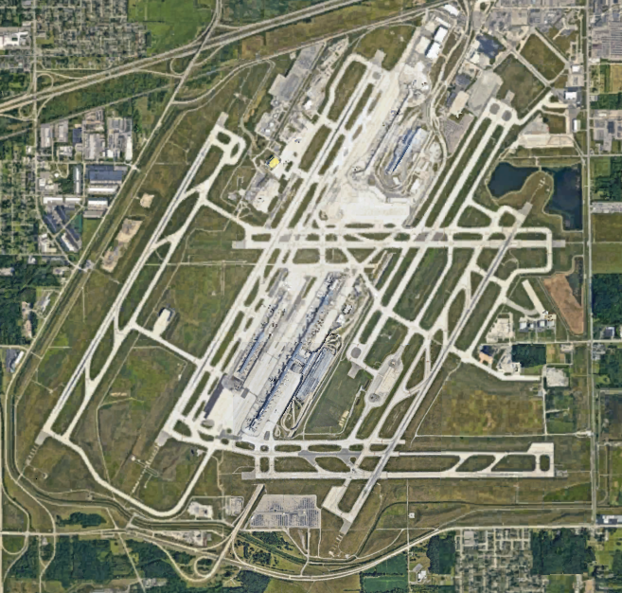
Osprey are the most hazardous hawk at airports (FAA 2024)
Large-bodied
Eat fish
Nest within 12 miles of fish
Commonly nest on towers
Breed & nest in Michigan (April)
Hatchlings fed fish
Migratory (September & March)
High nest-site fidelity
Long-lived (15+ years)
No nests at DTW
No strikes at DTW (yet)
Notes:
Notice the ponds, we recognize these attract osprey.
We are pushing to get this issue addressed…but unfortunately, we anticipate that things will not happen quickly.

Slide 3


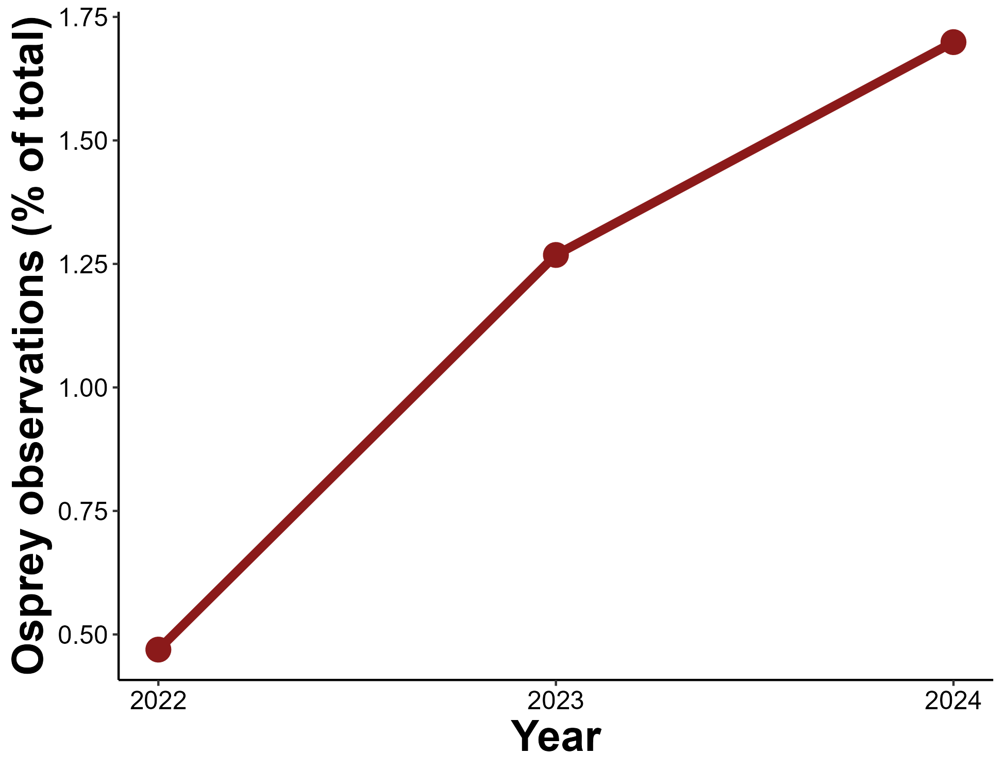
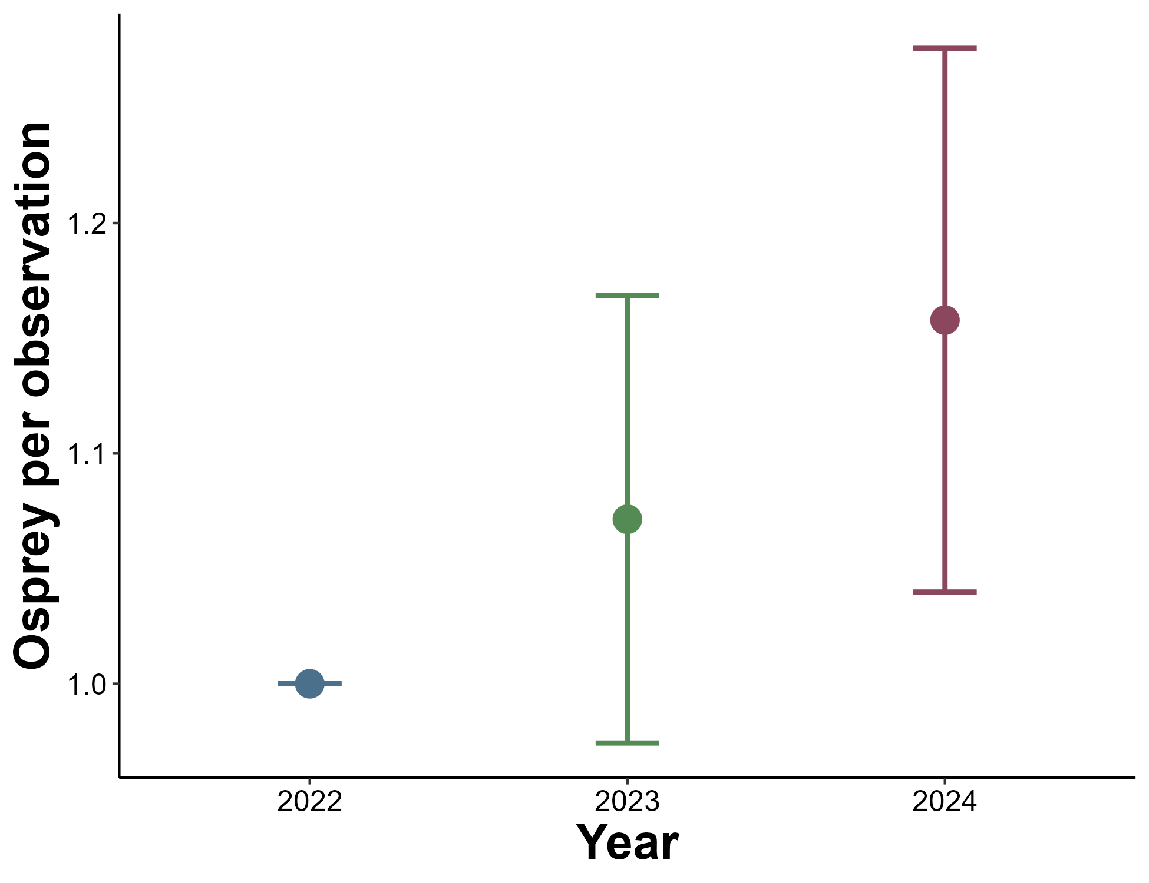
THE PROBLEM:
We’re observing osprey more frequently
and observing higher numbers
Notes:
Explain plots
Note that osprey observations have increased 3-fold since 2022.
And…we are observing significantly higher numbers of osprey per observation…over 1 bird on average.

Slide 4
OUR GOAL: Mitigate aviation hazards associated with osprey nesting near DTW
Proposed Actions:
Develop partnerships with tower managers and DTW wildlife team act as liaison
Remove unoccupied nests from towers (early 2025)
Install nest exclusion devices on towers (early 2025)
Notes:
Partner with tower managers, remove unoccupied nests from towers, and add exclusion devices to towers.

Slide 5
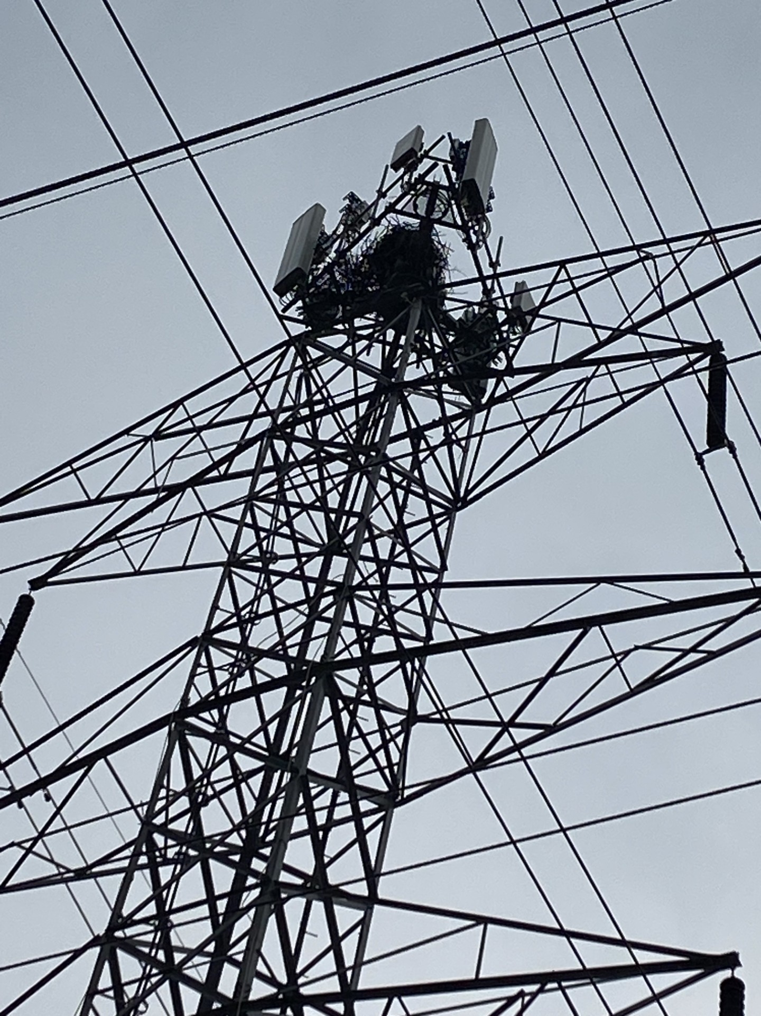
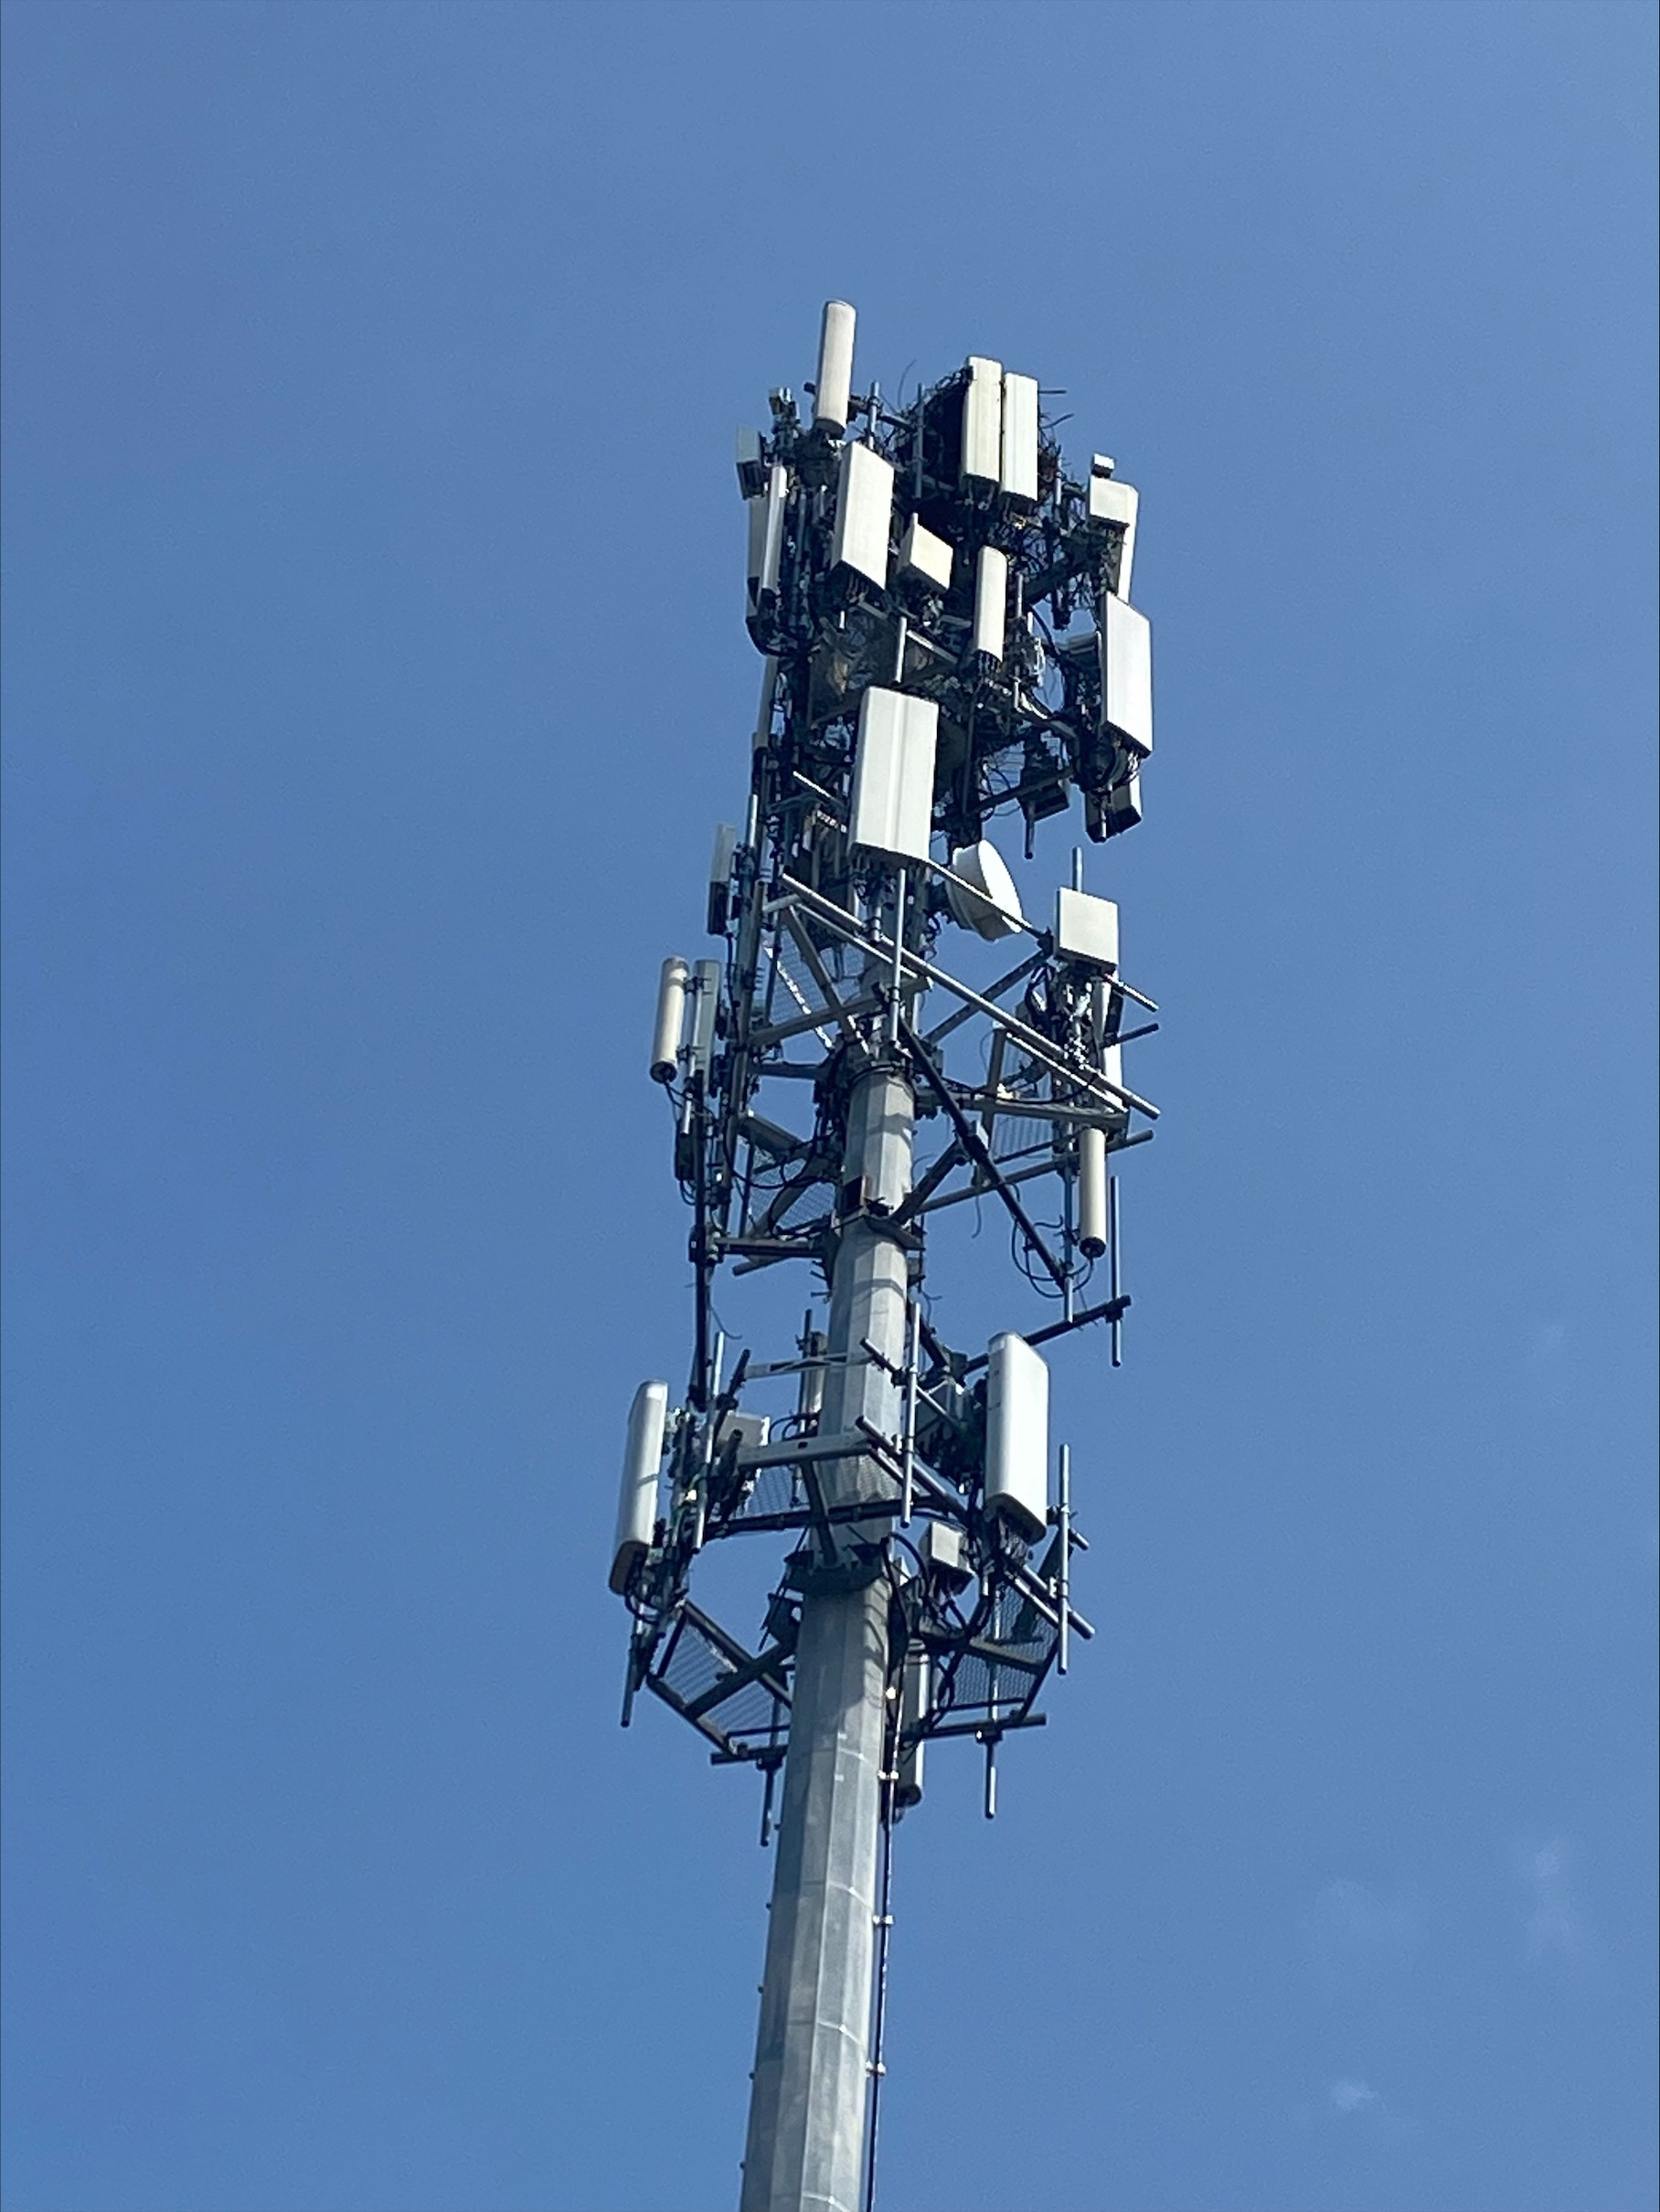
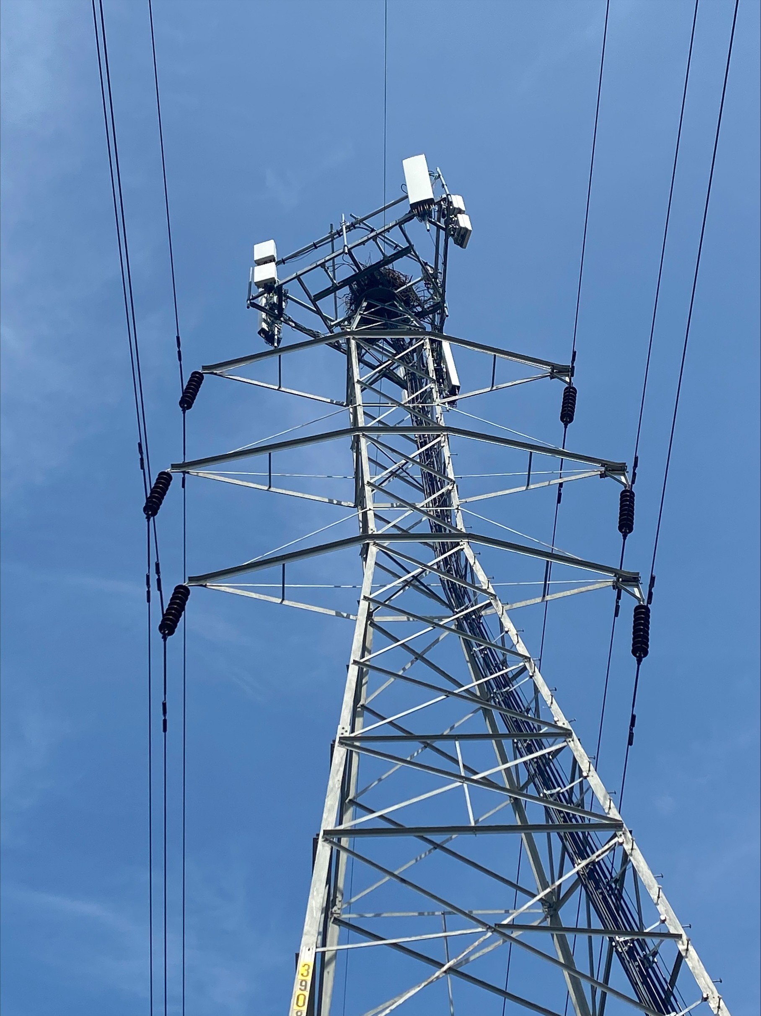
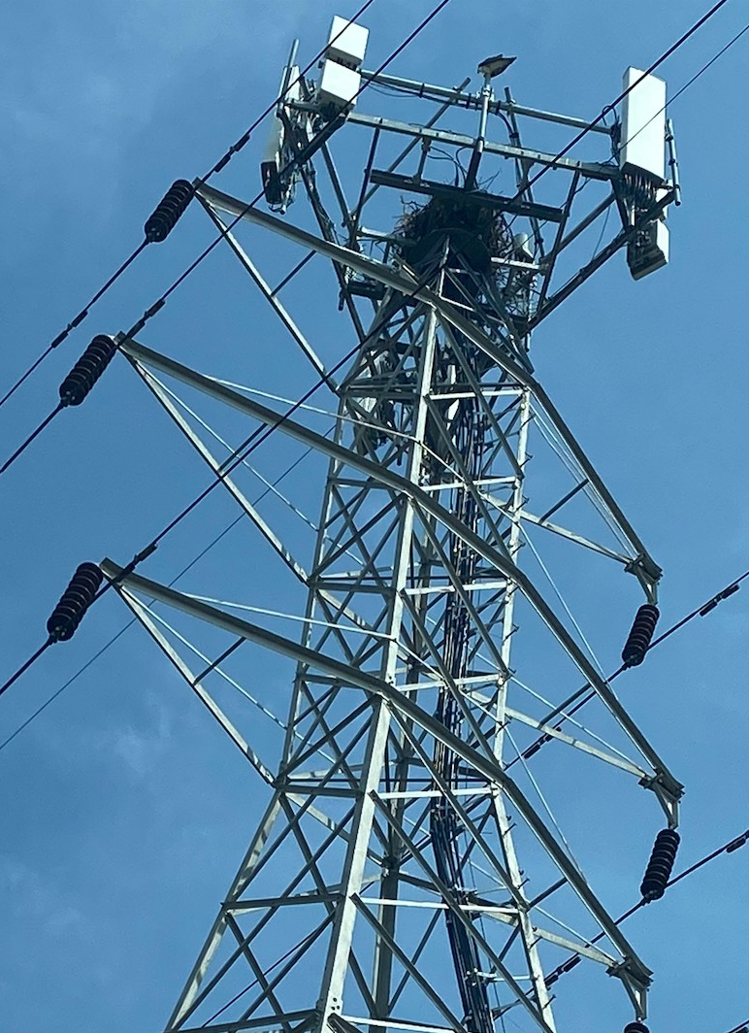
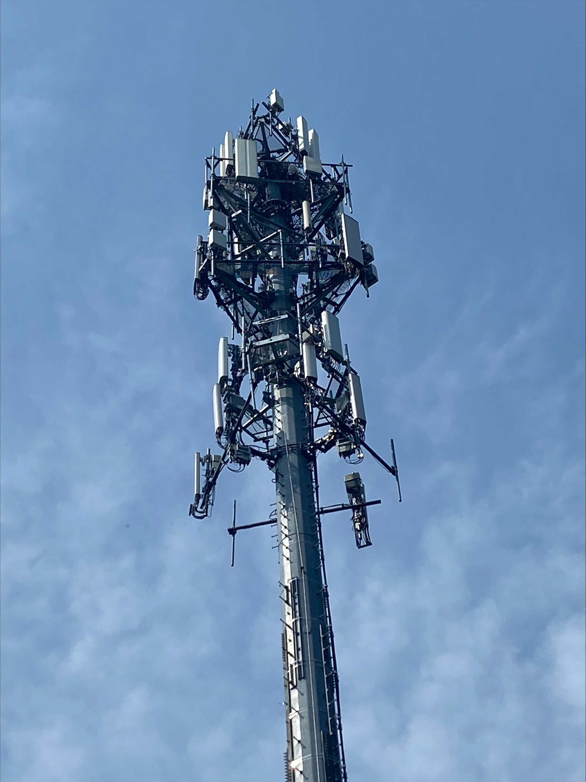
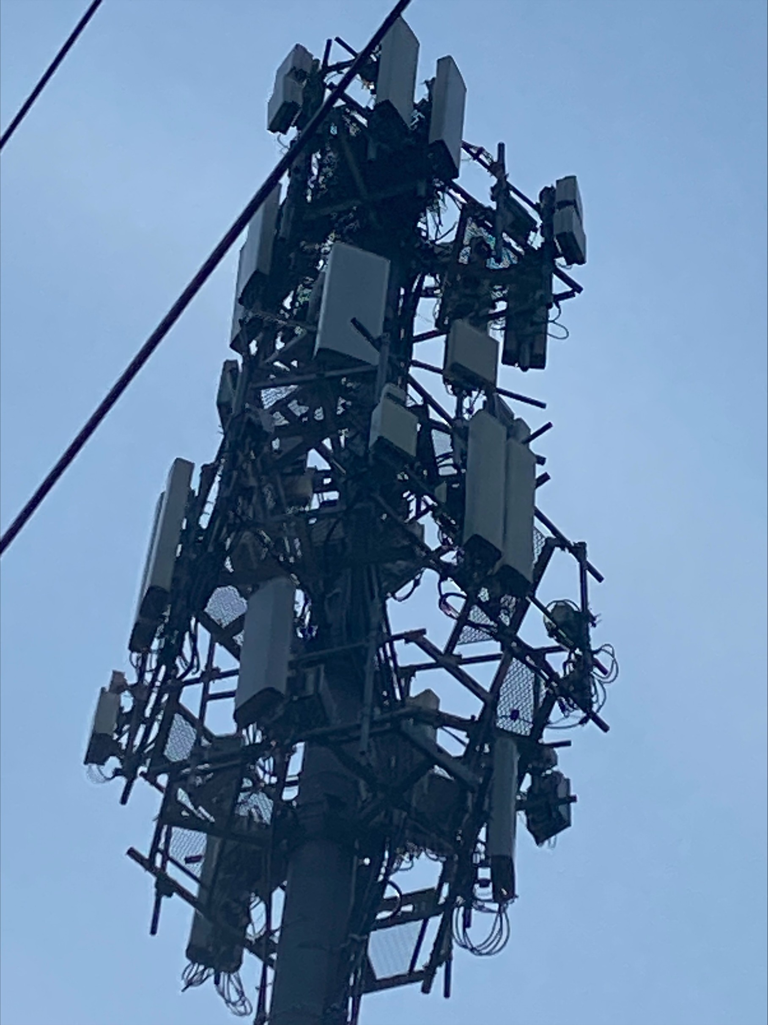
We found osprey nests at 6 of 42 tower sites
36 survey sites identified using Tower Maps data
6 additional survey sites found opportunistically
Notes:
So, we found 6 nests at 42 tower sites near the airport.

Slide 6
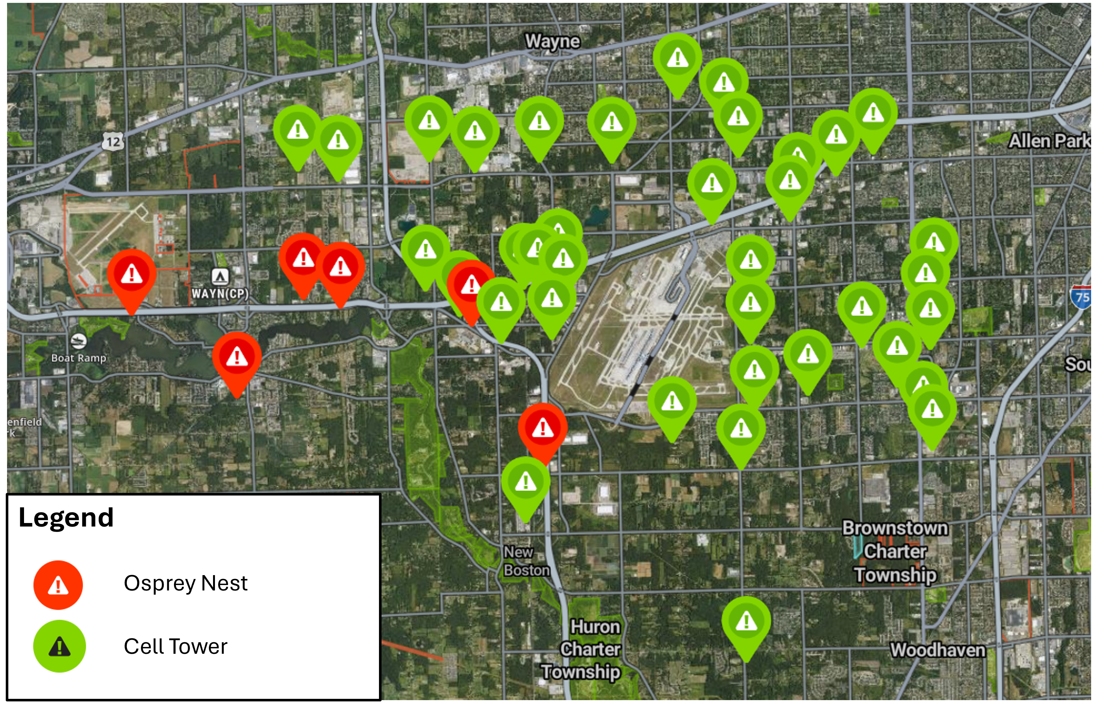
All nests found west of airport
Notes:
And all of those nest sites were found west of DTW.

Slide 7
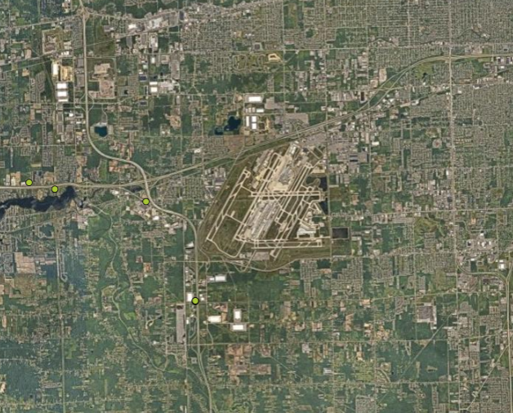
DTW’s 5-mile hazard buffer includes osprey nests
Notes:
And some were really close to the airport…within our wildlife management bubble.

Slide 8
DTW’s 5-mile hazard buffer includes osprey nests
Osprey fly across runways to access ponds
Notes:
And we suspect these nests are used by osprey we see flying back and forth across the runways all summer…flying to and from the ponds.

Slide 9
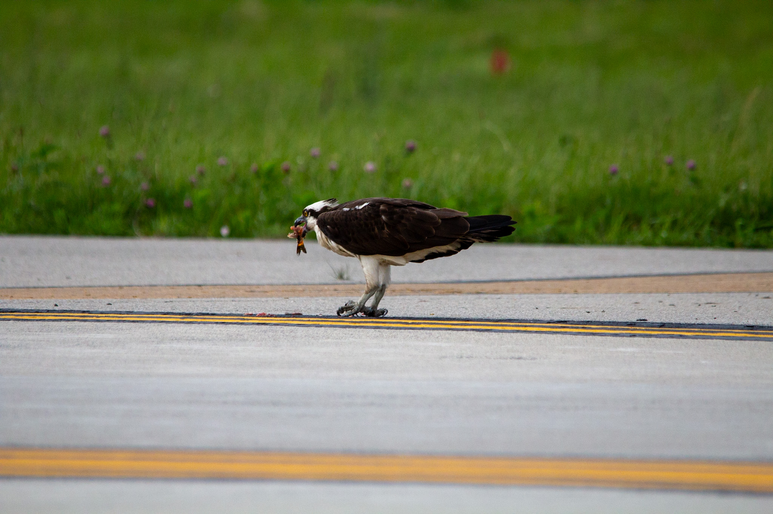
Osprey Initiative: Moving Forward
Multiple companies leasing tower space = challenge
Poor support from tower mangers & limited cooperation
Low confidence in work being completed this year
Continue conversations

